Slide 1
Semantic Modelling
for
Disaster Management Dataset
Team Members:
Mohamed Talha Hussain (2367793)
Abdul Khadar Mohammad (2334343)
Sahil Tambe (2353465)

Slide 2
Sahil Tambe
SID - 2353465

Slide 3
Efficient Disaster Response Coordination
Difficulty in synchronizing efforts between government agencies, NGOs, and private organizations during disasters
Ineffective collaboration leads to delayed aid and mismanagement of resources.
Example : During Hurricane Katrina (2005), poor coordination among agencies led to delayed evacuation and relief operations.

Slide 4
Accurate Impact Assessment and Resource Allocation
Lack of detailed, real-time assessment of casualties, damages, and affected populations delays resource allocation
Misjudgment often leads to inadequate aid in critical areas.
Example : The 2010 Haiti Earthquake highlighted resource misallocation when urban areas received more aid, while remote areas were underserved.

Slide 5
Improved Risk Assessment and Preparedness
Limited forecasting capabilities and inadequate risk evaluation leave communities unprepared for disasters.
Insufficient public awareness campaigns exacerbate vulnerabilities.
Example : In the 2004 Indian Ocean Tsunami, lack of early warning systems resulted in massive loss of life.

Slide 6
Streamlined Recovery and Rehabilitation Efforts
Post-disaster recovery often lacks structure, leading to prolonged economic and psychological hardships.
Efforts in reconstruction and rehabilitation are scattered and poorly monitored.
Example : Post-Hurricane Maria (2017), Puerto Rico faced significant delays in rebuilding infrastructure and reviving its economy.

Slide 7
Abdul Khadar Mohammad
SID - 2334343

Slide 8
What is Ontology?
Definition : A formal representation of knowledge with domain to facilitate communication and interoperability
Components : Classes, properties and relationships.
Overview of Disaster Management Ontology:
Focused on Disaster Management concepts: disaster type, Emergency response, Environmental Impact, Region.
Design using protege
Major Classes and properties: Disaster type, Region, Infrastructure damage, Environmental Impact.
Object Properties : hasregion, hassubtype, hasgroup,hasEndYear. Etc.,
Data Properties : CountryName, endDate, Response, locationName.

Slide 9
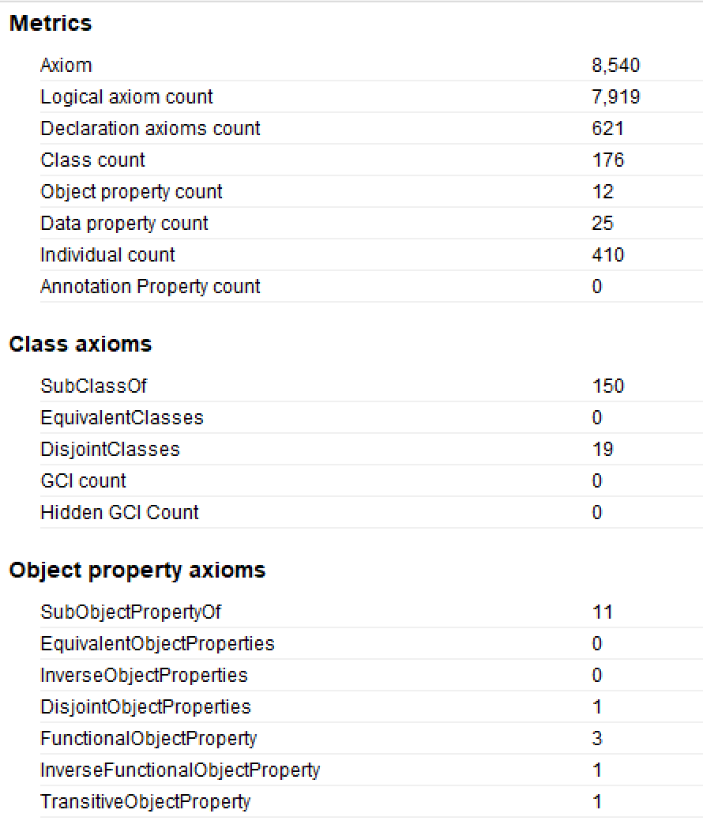
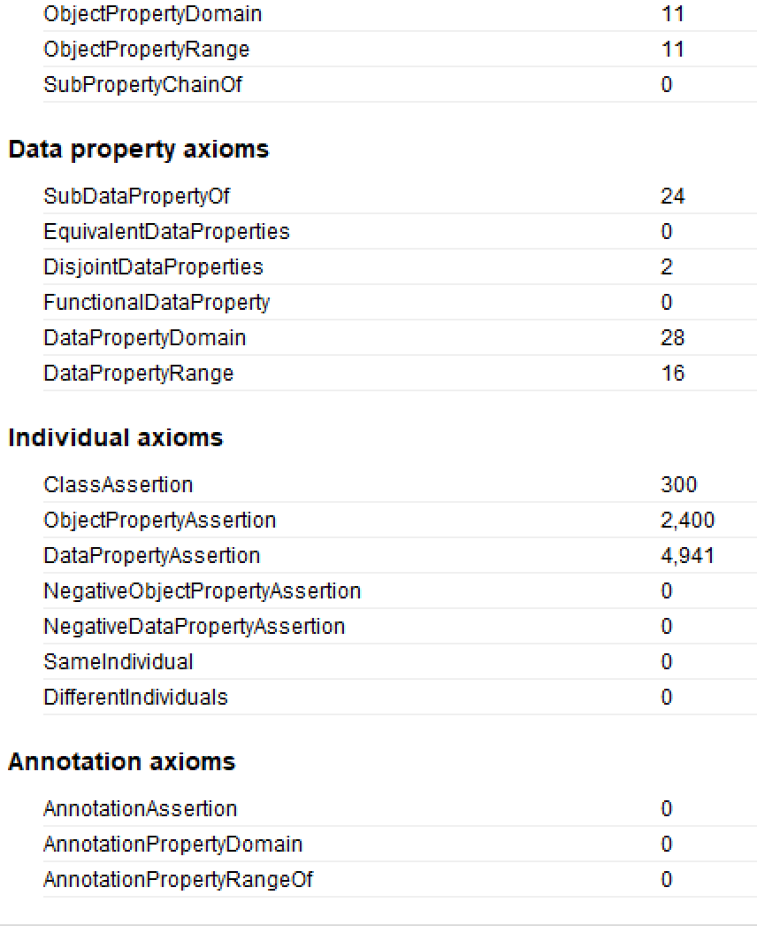
Ontology Metrics:
Ontology Metrics Count
Axioms 8,540
Logical axioms count 7,919
Declaration 201
Class Count 176
Object property Count 12
Data Property Count 25
Individual Count 410

Slide 10
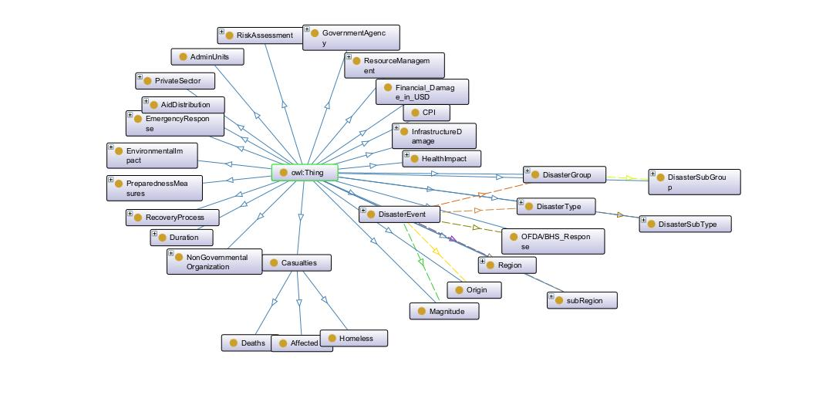
OntoGraf
OntoGraf is a visualization tool used to graphically explore and analyze the relationships between classes, properties, and individuals in an ontology.

Slide 11
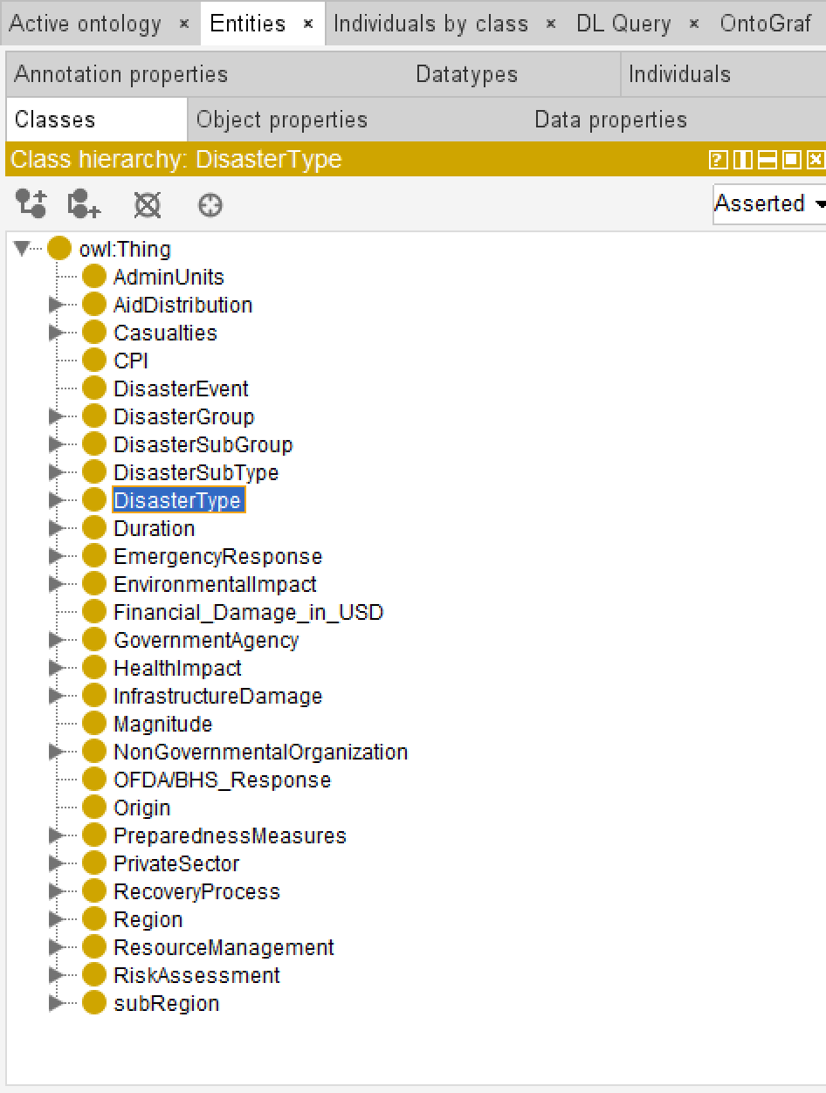
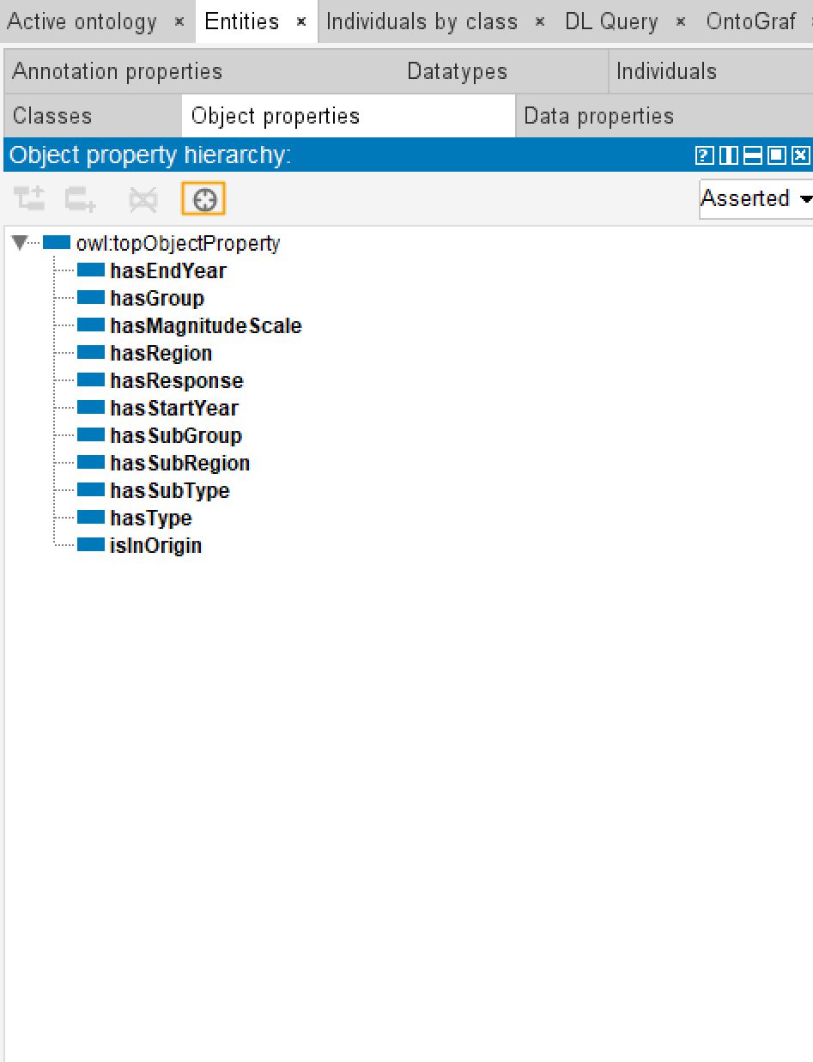
Ontology Design and Object Properties

Slide 12
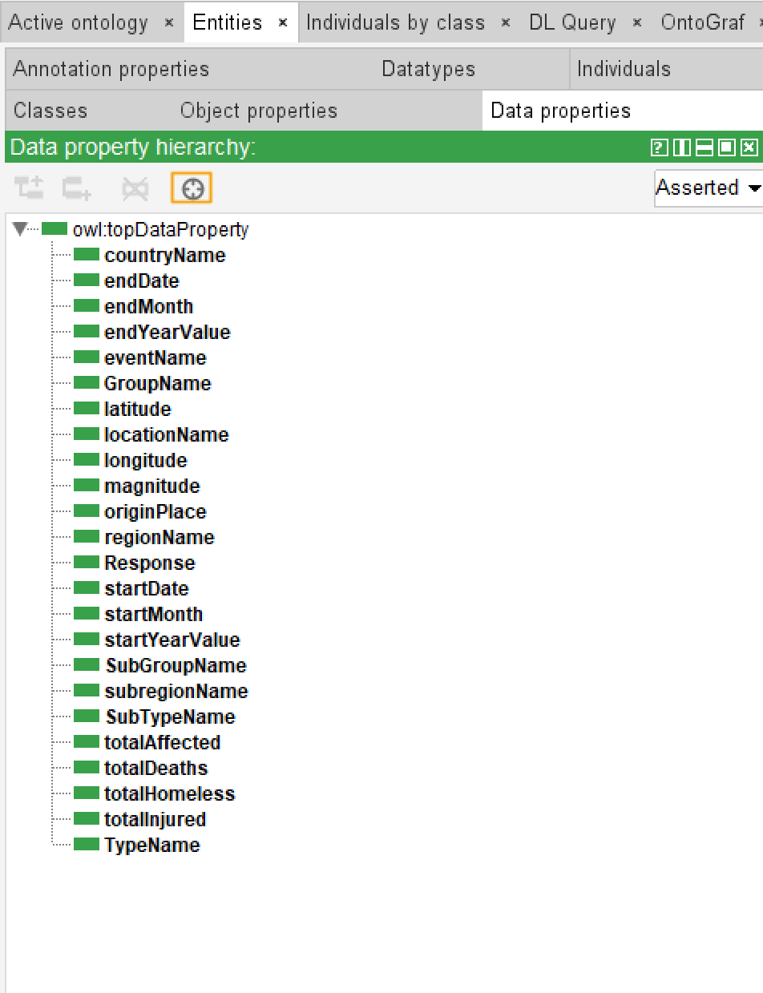
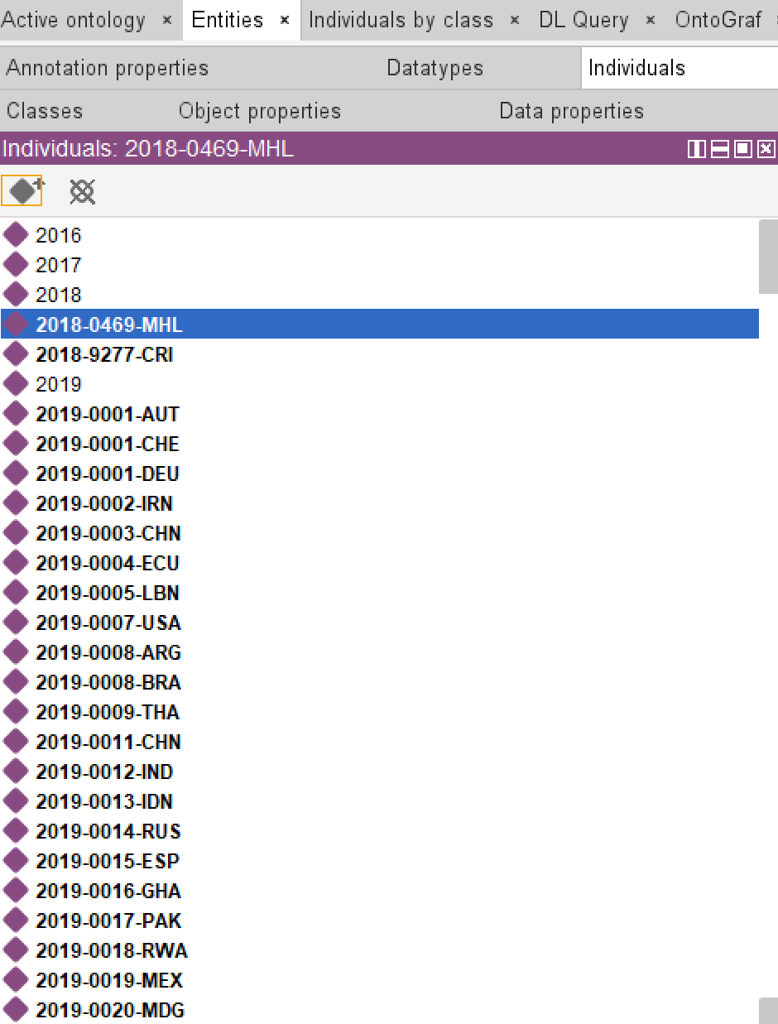
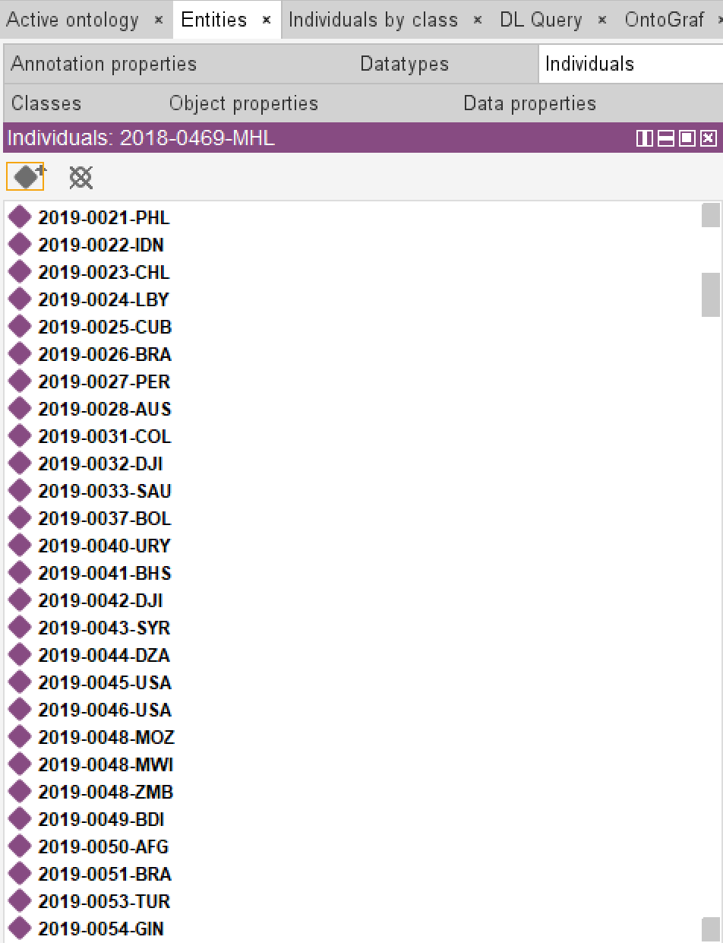
Data Properties and Individuals

Slide 13
Ontology Mapping
What is Ontology Mapping?
Ontology mapping is the process of establishing relationships and correspondences between two or more ontologies to
enable data integration, interoperability, and knowledge sharing.
Ontology Overview:
Represents relationships between disaster events, types, and geographic regions.
Allows semantic querying and logical inference for disaster data.
Key Components:
Classes: DisasterType, RegionName .
Properties: hasStartYear, endYearValue, regionName, subClassOf.
Example Mapping:
Triple: "2019-0328-TUN" → hasStartYear → "2016."
Class Mapping:
Entity: "Miscellaneous_accident_(General)" → Class: DisasterType.

Slide 14
Mohamed Talha Hussain
SID - 2367793

Slide 15
Requirement Mapping
Question | Mapping
 | Classes | Properties
1. Display the number of deaths and injuries caused by the Viral diseases in Asia? | DisasterEvent Region Subtype | eventName regionName totalDeaths SubTypeName totalInjured
2. List the number of disasters occurred in each region? | DisasterEvent Region | regionName
3. Name the top 3 types disasters and their locations with the highest magnitude? | DisasterEvent SubType | eventName magnitude locationName subTypeName

Slide 16
Question | Mapping
 | Classes | Properties
4. What is the total number of people left homeless due to disasters? | DisasterEvent | totalHomeless
5. List the 3 major disasters of 2022 with their countries? | DisasterEvent Duration | regionName totalAffected countryName startYearValue

Slide 17
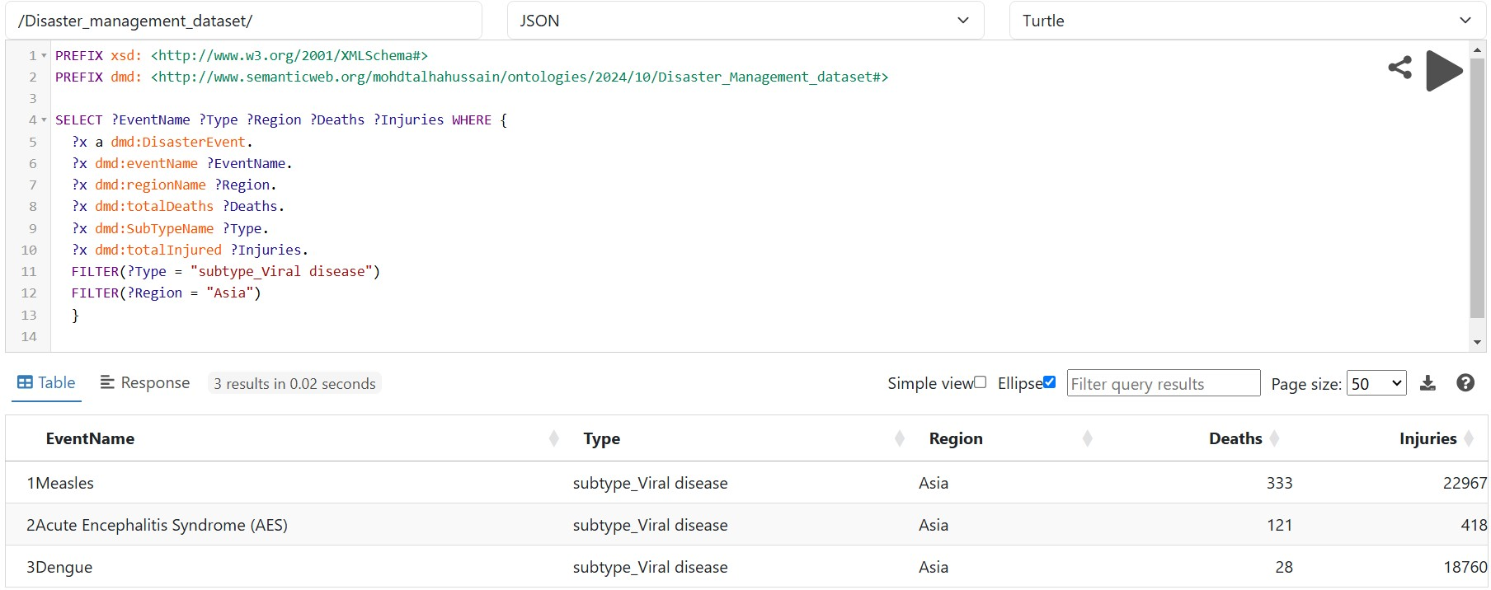
Display the number of deaths and injuries caused by the Viral diseases in Asia?

Slide 18
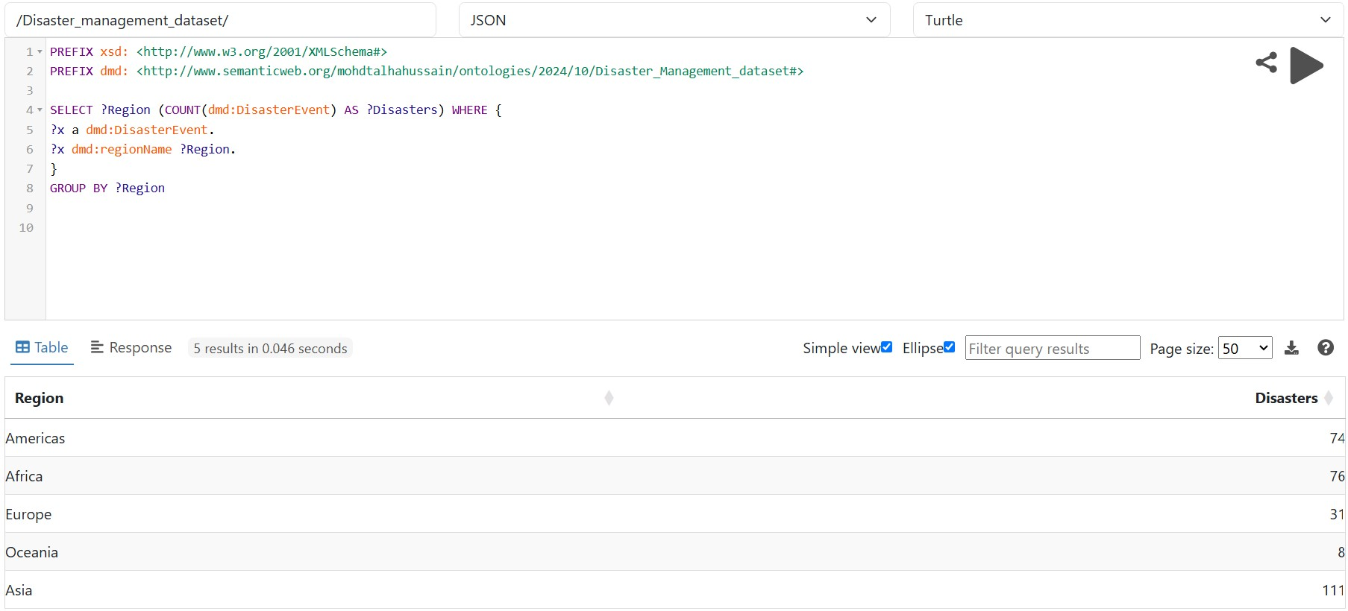
2. List the number of disasters occurred in each region?

Slide 19
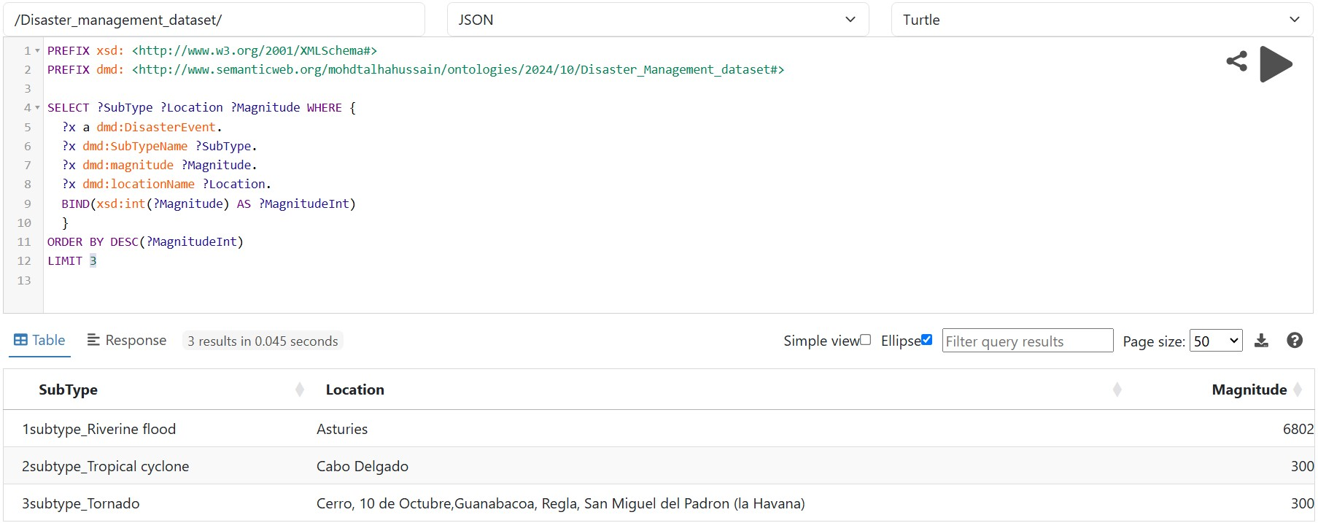
3. Name the top 3 types disasters and their locations with highest magnitude?

Slide 20
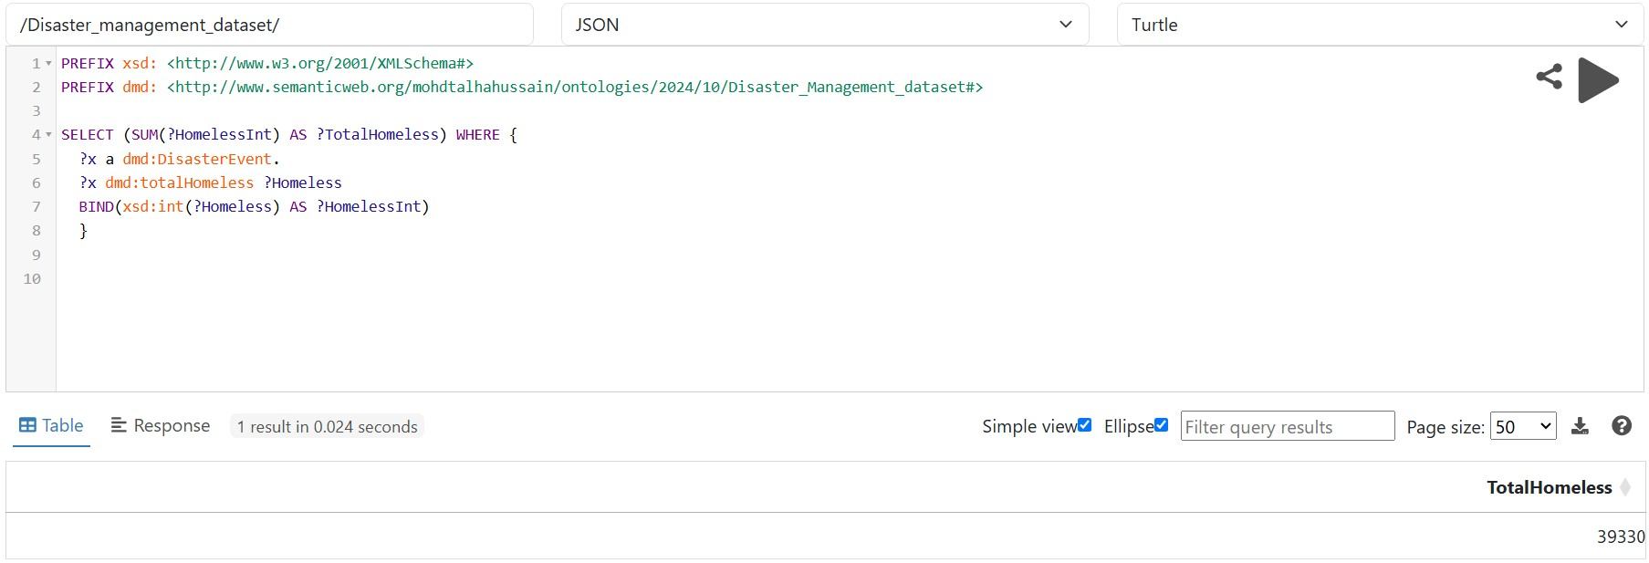
4. What is the total number of people left homeless due to disasters ?

Slide 21
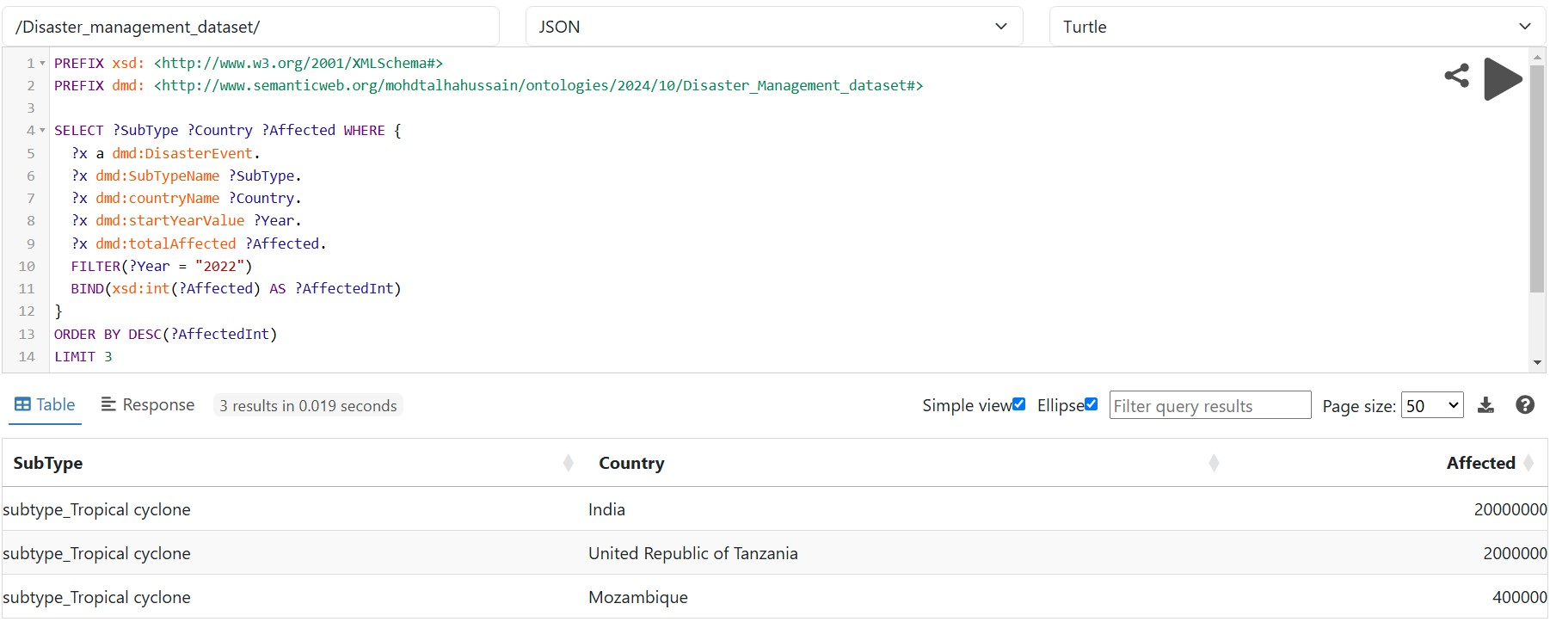
5. List the 3 major disasters of 2022 with their countries?

Slide 22

Programming?
AI ?
the list for disasterews @ in Asia yfgtyftu an&% d how man y di*ed tolls.
Human Language ?
NLP ?

Slide 23
Programming :
Input
x=2
Logic
y=x^2
Output
y=4
AI :
Input
x=2
x=3
x=4
x=5
Output
y=4
y=9
y=16
y=?
Logic
y=x^2
y=25

Slide 24
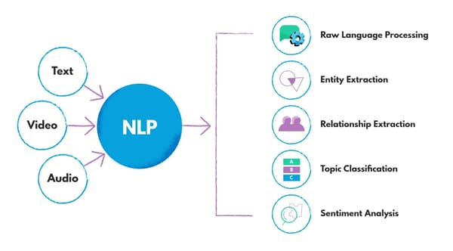

Slide 25
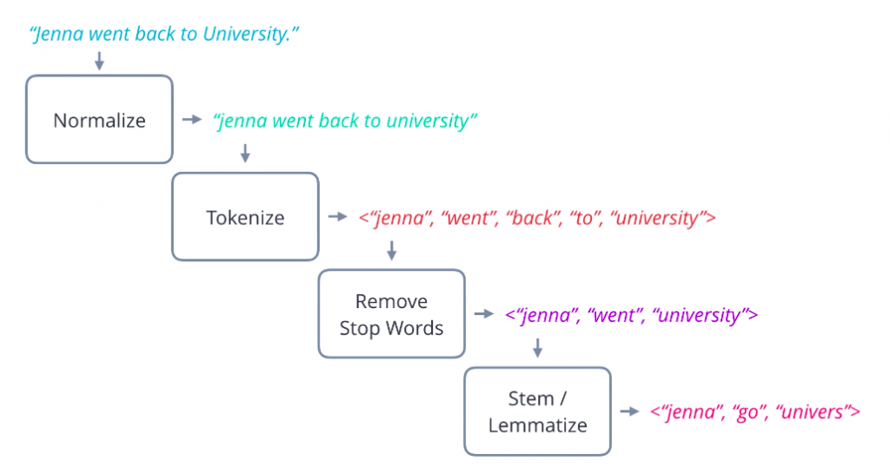
NLP Techniques
the list for disasterews @ in Asia yfgtyftu an&%d how many di*ed tolls
the list for disasterews in Asia yfgtyftu and how many died tolls
[‘the’, 'list', ‘for’, 'disasterews', ‘in’, 'Asia', 'yfgtyftu', ‘and’, ‘how’, 'many', 'died', 'tolls']
['list', 'disasterews', 'Asia', 'yfgtyftu', 'died', 'toll']
Stemming
['list', 'disaster', 'Asia', 'yfgtyftu', 'die', 'toll']
['list', 'disast', 'Asia', 'yfgtyftu', 'man', 'di', 'toll']

Slide 26
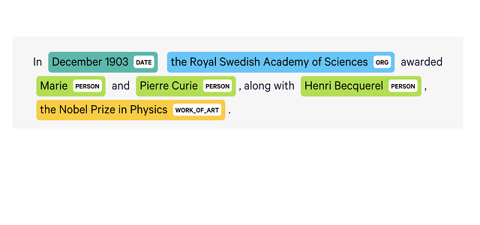
NER
['list', 'disaster', 'Asia', 'yfgtyftu', 'die', 'toll']
['list', 'disaster', 'Asia', 'yfgtyftu', 'die', 'toll', ‘in’, ‘2022’, ‘loc’]
Bag of Words
['list', 'disaster', 'Asia', 'yfgtyftu', 'die', 'toll', ‘in’, ‘2022’, ‘loc’]
['eventName'] ['totalDeaths', 'regionName']
the list for disasterews @ in Asia yfgtyftu an&%d how many di*ed tolls
['eventName'] ['totalDeaths', 'regionName']

Slide 27
Query Generation
sparql_query += "\n".join([f"?event <http://www.semanticweb.org/mohdtalhahussain/ontologies/2024/10/Disaster_Management_dataset#{prop}> ?{prop}." for prop in query_properties])
?event a <http://www.semanticweb.org/mohdtalhahussain/ontologies/2024/10/Disaster_Management_dataset#DisasterEvent>.
?event <http://www.semanticweb.org/mohdtalhahussain/ontologies/2024/10/Disaster_Management_dataset#eventName> ?eventName.?event <http://www.semanticweb.org/mohdtalhahussain/ontologies/2024/10/Disaster_Management_dataset#totalDeaths> ?totalDeaths.
?event <http://www.semanticweb.org/mohdtalhahussain/ontologies/2024/10/Disaster_Management_dataset#regionName> ?regionName.FILTER(?regionName = "Asia")

Slide 28

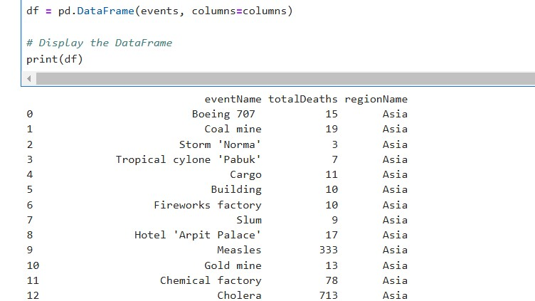

Slide 29

Interface

Slide 30
Modules used:
import nltk
from nltk.tokenize import word_tokenize
from nltk.stem import WordNetLemmatizer
from nltk.corpus import stopwords
import re
from string import punctuation
from SPARQLWrapper import SPARQLWrapper2
import speech_recognition

Slide 31
Thank You

